Slide 1
Introduction to Decision & Regression Tree

Slide 2
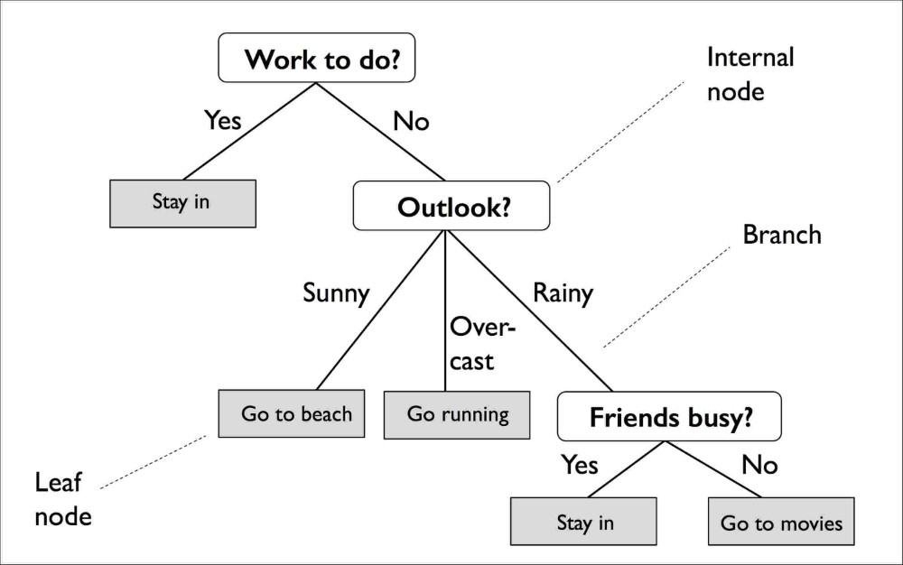
What is a Decision Tree?
A tree structure where
Each internal node is a test on some attribute.
Each branch is outcome of the test
Each leaf node is one of the predefined classes
Used for predictive analysis

Slide 3
Tree induction algorithms are used to construct DT from the training set.
ID3 (Iterative Dichotomiser 3)
A recursive procedure to construct DT
Takes set of training samples and list of attributes as input
Returns tree structure as output
It has to make following decisions while constructing a tree
When a new node is created, it should become leaf node or internal node?
If it becomes a leaf node then it should be labeled with which class name?
If it becomes an internal node then it should be labeled with which attribute and how many branches it will have?
What are parameters to be passed to the recursive call?

Slide 4
Generate_tree (set of samples S, attribute list)
Create a node N;
If all samples in S belong to the same class C then
Return N as leaf node labeled with the class C;
If attribute list is empty then
Return N as leaf node labeled with the most common class in the set of samples;
Select the attribute with the highest information gain as test attribute;
Label the node N with the test attribute;
gender
male
female

Slide 5

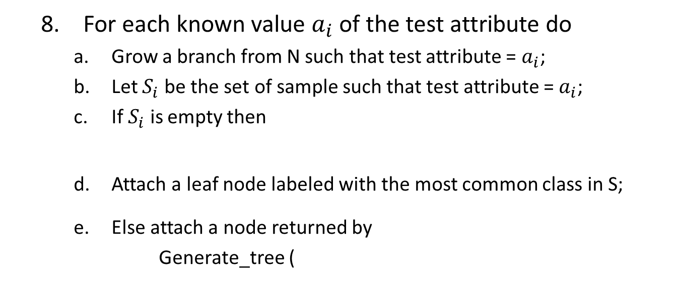
For each known value $a_{i}$ of the test attribute do
Grow a branch from N such that test attribute = $a_{i}$;
Let $S_{i}$ be the set of sample such that test attribute = $a_{i}$;
If $S_{i}$ is empty then
Attach a leaf node labeled with the most common class in S;
Else attach a node returned by
Generate_tree (
gender
male
$S_{i}$, attribute list – test attribute)

Slide 6
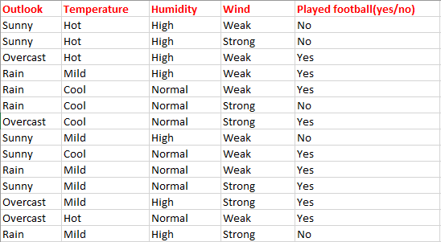
Step 1: create a node N;
Step 2: condition is false
Step 4: condition is false
Step 6: select the attribute with the highest information gain as test attribute;

Slide 7
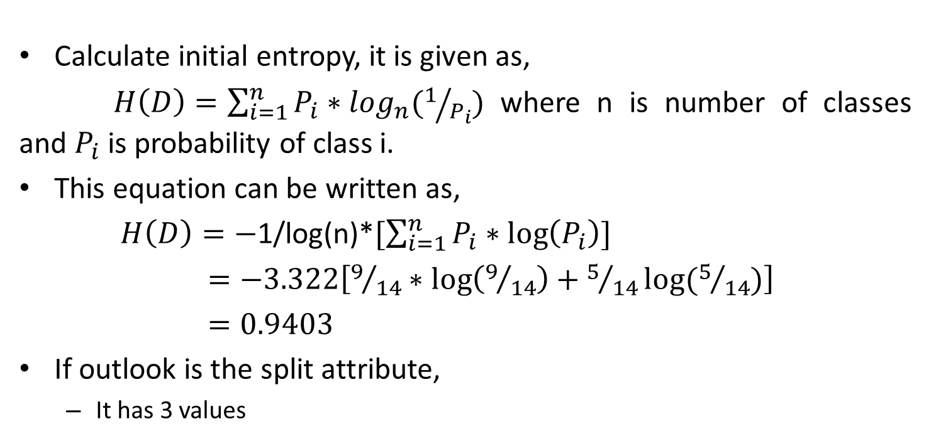
Calculate initial entropy, it is given as,
$H\left(D\right)=\sum_{i=1}^{n}{P_{i}∗\log_{n}(1/{P_{i}})}$ where n is number of classes and $P_{i}$ is probability of class i.
This equation can be written as,
$H\left(D\right)=−$1/log(n)*$[\sum_{i=1}^{n}{P_{i}∗\log\left(P_{i}\right)}]$
$=−3.322\left[9/{14}∗\log\left(9/{14}\right)+5/{14}log⁡(5/{14})\right]$
$=0.9403$
If outlook is the split attribute,
It has 3 values
Sunny (5 samples)
Overcast (4 samples)
Rain (5 samples)
2 (Yes)
4 (Yes)
3 (Yes)
3 (No)
0 (No)
2 (No)

Slide 8
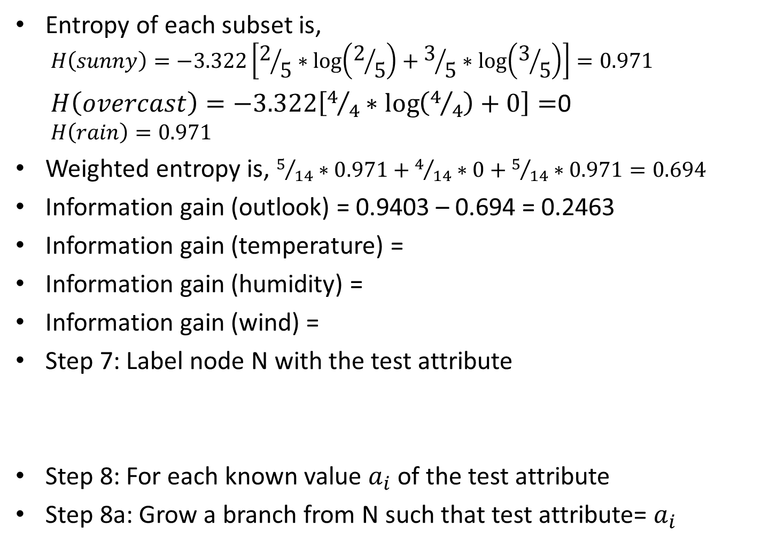
Entropy of each subset is,
$$H\left(sunny\right)=−3.322\left[2/5∗\log\left(2/5\right)+3/5∗\log\left(3/5\right)\right]=0.971$$
$H\left(overcast\right)=−3.322\left[4/4∗\log\left(4/4\right)+0\right]=$0
$$H\left(rain\right)=0.971$$
Weighted entropy is, $5/{14}∗0.971+4/{14}∗0+5/{14}∗0.971=0.694$
Information gain (outlook) = 0.9403 – 0.694 = 0.2463
Information gain (temperature) =
Information gain (humidity) =
Information gain (wind) =
Step 7: Label node N with the test attribute
Step 8: For each known value $a_{i}$ of the test attribute
Step 8a: Grow a branch from N such that test attribute= $a_{i}$
outlook

Slide 9

outlook
sunny
Step 8b: Let $S_{i}$ be the set of samples such that test attribute=$a_{i}$
Step 8c: condition is false
Step 8e: attach a node returned by Generate_tree($S_{i}$, attribute list–test attribute)
outlook
sunny

Slide 10
outlook
sunny
Created by recursive call
Created by recursive call for loop
humidity
high
normal
No
Yes
Created by next recursive call

Slide 11
What is regression tree?
A variant of DT
A Decision tree which built for a data set whose target variable is continuous (numeric) is called regression tree.
Day | Outlook | Temp. | Humidity | Wind | Golf Players
1 | Sunny | Hot | High | Weak | 25
2 | Sunny | Hot | High | Strong | 30
3 | Overcast | Hot | High | Weak | 46
4 | Rain | Mild | High | Weak | 45
5 | Rain | Cool | Normal | Weak | 52
6 | Rain | Cool | Normal | Strong | 23
7 | Overcast | Cool | Normal | Strong | 43
8 | Sunny | Mild | High | Weak | 35
9 | Sunny | Cool | Normal | Weak | 38
10 | Rain | Mild | Normal | Weak | 46
11 | Sunny | Mild | Normal | Strong | 48
12 | Overcast | Mild | High | Strong | 52
13 | Overcast | Hot | Normal | Weak | 44
14 | Rain | Mild | High | Strong | 30

Slide 12
Information gain for attribute selection is based on standard deviation rather than entropy
Calculate initial SD
Calculate SD after splitting dataset on an attribute
Calculate weighted SD
Information gain = initial SD – weighted SD
Select a threshold on number samples to prevent further split
Label leaf node with the average of target variable in the dataset

Slide 13
Tree pruning
Overfitting problem
Occurs due to presence of outliers or over-learning
Difficulty in generalization
Can be solved using tree pruning methods
There are two approaches
Pre-pruning: Wrong branches are deleted before entire tree is fully grown
Difficult to select threshold for goodness of split
Tree construction slows down
Post pruning: Wrong branches are deleted from the fully grown tree
More difficult to implement
Tree pruning slows down

Slide 14
Thank You

